Slide 1


DEEP LEARNING BASED BREAST CANCER PREDICTION SYSTEM
STATS & FACTS
Stephen Gathai.
Tony Munene.
Loise Mbago.
Nazra Nyangwara.
Cleophas Opati.
Immanuel Omondi.
Bahati Ndwiga.

Slide 2

TABLE OF CONTENT
Business Overview
Problem statement
Objectives
Success Criteria
Data Understanding
Data Preparation
Modelling
Conclusions
Recommendations

Slide 3
Business Overview
Breast cancer is a leading global cancer and the second most common cause of cancer-related deaths, particularly among women aged 45-55.
Early detection is crucial for improving breast cancer outcomes, with proper diagnosis and treatment significantly enhancing survival rates.
Mammography and ultrasound are primary tools for early breast cancer diagnosis, but they have limitations. They often lead to false positives, requiring follow-up tests like aspiration or biopsy after a breast ultrasound. Some tumours also go undetected by ultrasound, and annual mammography can miss early tumours presenting as calcifications. Advanced tools are needed for more effective early breast cancer detection.

Slide 4
Problem Statement
The breast cancer research foundation (BCRF) has partnered with us to develop a breast cancer prediction system(BCPS) aimed at using deep learning technology to enhance early breast cancer detection.
This system will analyse medical imaging data, such as mammograms and ultrasounds, to detect breast cancer presence with a high degree of accuracy. Through the deep learning-bcps, BCRF seeks to transform breast cancer research, improving the precision and efficiency of diagnosis, providing a valuable tool for healthcare professionals to enable timely intervention, enhance patient outcomes, and support decision-making.
.

Slide 5
Objectives
To develop a deep learning model capable of efficient segmentation of breast masses in ultrasound images.
To identify critical parameters for breast cancer detection
To implement a user-friendly interface for healthcare professionals to upload medical images and receive predictions.
To develop a model with at least 90% specificity and 90% sensitivity for accurate predictions.

Slide 6
Success Criteria
Achieve a classification accuracy of at least 85% on the test dataset
Achieve a sensitivity of at least 90% and a specificity of at least 90%
Demonstrate good generalization by performing well on unseen data
Have a high F1-score to ensure a balance between precision and recall

Slide 7

Data Understanding
The project used one dataset, consisting of ultrasounds from the IN-breast database.
The dataset has 780 breast ultrasound images from 600 female patients aged between 25 and 75 years.
The data is categorized into three sets:
Benign-has 437 images.
Malignant-has 210 images.
Normal-has133 images.

Slide 8
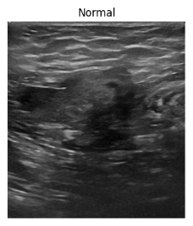
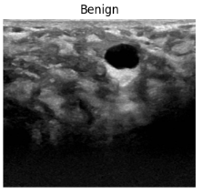
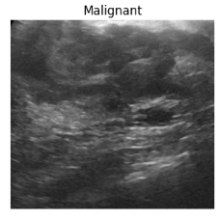
Sample Images
A normal image is mostly grey, with some white areas showing healthy dense tissue.
A Benign mass is usually circumscribed oval and round, it has a regular shape.
An irregular shape suggests a greater likelihood of malignancy.

Slide 9
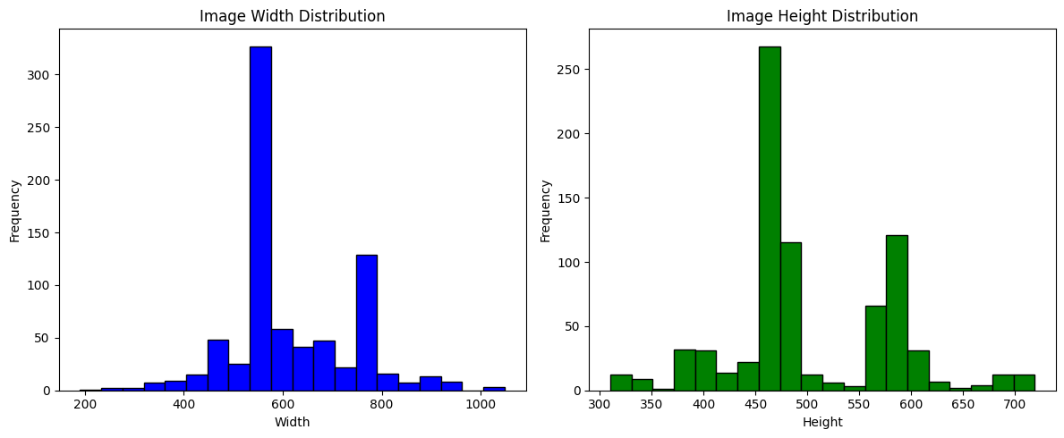
Image Sizes
The Images vary in width and height.

Slide 10
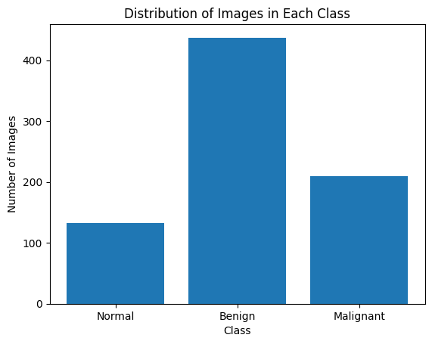
Image distribution per class
The output reveals a noticeable class imbalance in the dataset
The benign category is significantly over represented compared to the other categories.

Slide 11
Data Preparation
This step involved:
Addressing class imbalance
Resizing the images to a consistent size
Normalizing the pixel values to a range between 0 and 1
Creating labels for each class
Applying data augmentation techniques to increase the variability and size of the training dataset

Slide 12
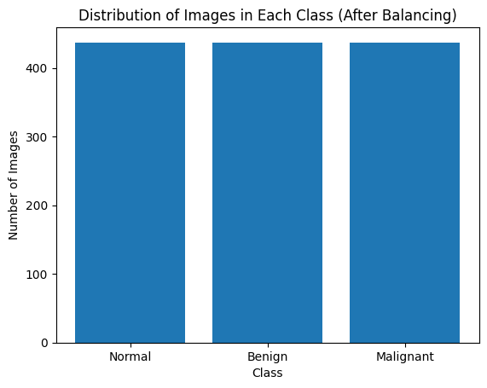
Image distribution after handling class Imbalance
The Class Imbalance was completely addressed.
Each category has 437 images.

Slide 13
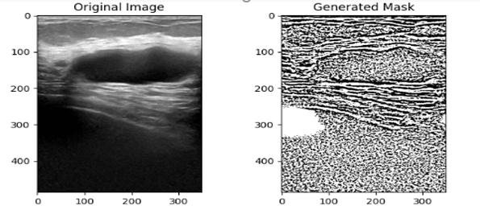
Mask Application
Masking is crucial for possibly highlighting areas with cancerous cells as denoted by the white patch.

Slide 14
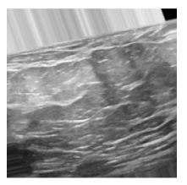
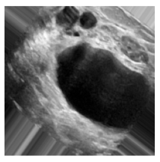
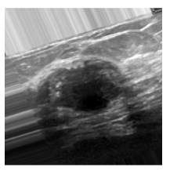
Image Augmentation
Data Augmentation increased the images form 1311 to 13110
Augmented Normal image
Augmented Benign image
Augmented Malignant image

Slide 15
Modeling
The Following models were used;
Baseline CNN model
Baseline CNN model with additional layers
Pretrained VGG16 model

Slide 16
Modelling results and Evaluation
Models | Accuracy | Recall Normal | Recall Benign | Recall Malignant
Baseline Model CNN | 0.81 | 0.88 | 0.71 | 0.84
Model 2_CNN Model with added layer | 0.34 | 0.04 | 0.00 | 0.99
Model 3_VGG16 | 0.53 | 0.54 | 0.49 | 0.56
The baseline CNN model achieved an accuracy of 81%. It also demonstrated a balanced performance in terms of precision, recall, and F1-score, with values approximately around 0.88 for recall in the "Normal" class, 0.71 for recall in the "Benign" class, and 0.84 for recall in the "Malignant" class
This was the best model at predicting the cancer detection in the images.

Slide 17

Conclusions
1.With specificity and sensitivity over 81%, The model shows promise in positively impacting early breast cancer detection and healthcare decisions
2. The model's training progress reveals steady improvement in breast cancer image classification, reflected by decreasing loss, indicating effective learning and convergence.
3.Overall, our deep learning based breast cancer prediction system holds significant promise for improving detection and intervention in breast cancer cases

Slide 18

Recommendations
Experiment with different model architectures and pretrained models like ResNet, Inception, or Efficient Net to enhance model performance.
Establish a feedback loop with clinicians for model refinement.
Expand the dataset with more diverse samples for increased model robustness.
Incorporate patient metadata and clinical parameters for improved accuracy

Slide 19



Thank you!
Q&A?

